Slide 1
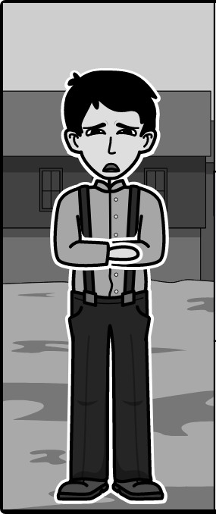
Eliezer (Elie) Wiesel (Ch. 1-9)
Directions | Example | Index | Schedule
Elie’s Faith at the Beginning of The Novel (Chapter 1: pre-Holocaust)
Elie’s Faith at the Middle of The Novel (Chapters 2-6: Atrocities)
Elie’s Faith at the End of The Novel (Chapters 7-9: Loss & Liberation)
Elie believes in God and studies the Talmud and Jewish mysticism under the guidance of Moishe the Beadle “[Moishe] spoke to me for hours on end about the Kabbalah's revelations and its mysteries. Thus began my initiation. Together we would read, over and over again, the same page of the Zohar. Not to learn it by heart but to discover within the very essence of divinity” (Wiesel 5).
__________Your Claim___________. “_____Supporting Quote______” (Wiesel _Page Number_).
__________Your Claim___________. “_____Supporting Quote______” (Wiesel _Page Number_).
Chapter 1
(pre-Holocaust)
Chapters 2-6
(Atrocities)
Chapters 7-9
(Loss & Liberation)

Slide 2
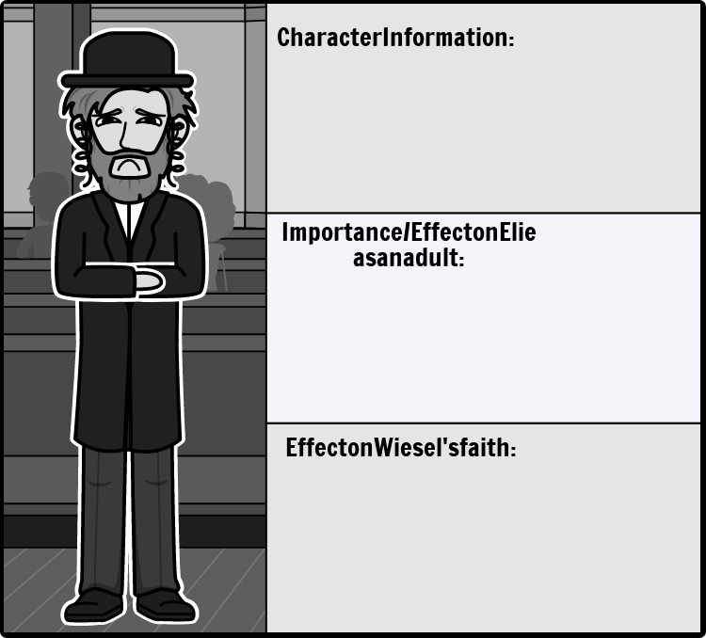
Moishe the Beadle (Ch. 1)
Directions | Example | Index | Schedule
Insert notes/observations.
Insert notes/observations.
Insert notes/observations.
__________Your Claim___________. “_____Supporting Quote______” (Wiesel _Page Number_).
__________Your Claim___________. “_____Supporting Quote______” (Wiesel _Page Number_).
__________Your Claim___________. “_____Supporting Quote______” (Wiesel _Page Number_).

Slide 3
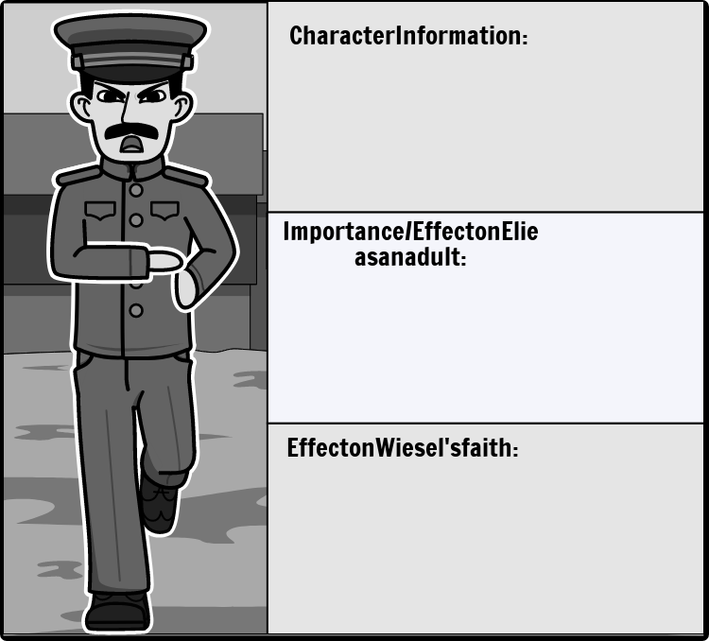
Idek (Ch. 4)
Directions | Example | Index | Schedule
Insert notes/observations.
Insert notes/observations.
Insert notes/observations.
__________Your Claim___________. “_____Supporting Quote______” (Wiesel _Page Number_).
__________Your Claim___________. “_____Supporting Quote______” (Wiesel _Page Number_).
__________Your Claim___________. “_____Supporting Quote______” (Wiesel _Page Number_).

Slide 4
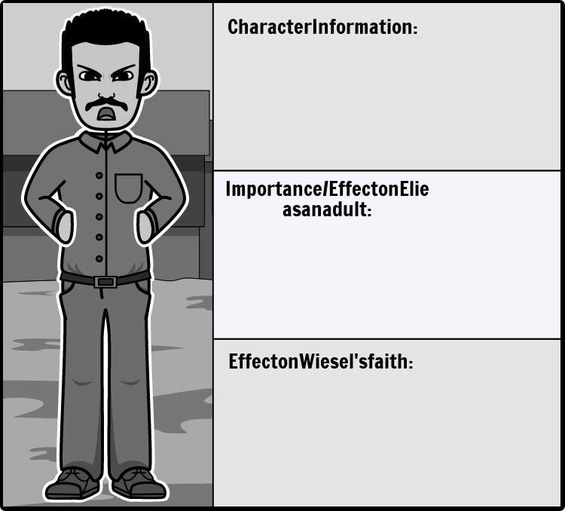
Franek (Ch. 4)
Directions | Example | Index | Schedule
Insert notes/observations.
Insert notes/observations.
Insert notes/observations.
__________Your Claim___________. “_____Supporting Quote______” (Wiesel _Page Number_).
__________Your Claim___________. “_____Supporting Quote______” (Wiesel _Page Number_).
__________Your Claim___________. “_____Supporting Quote______” (Wiesel _Page Number_).

Slide 5
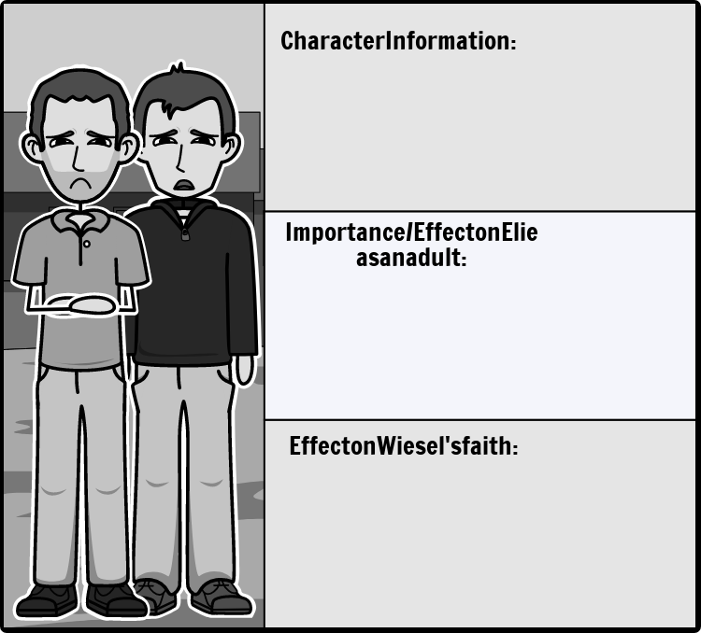
Tibi & Yosi (Ch. 4-5)
Directions | Example | Index | Schedule
Insert notes/observations.
Insert notes/observations.
Insert notes/observations.
__________Your Claim___________. “_____Supporting Quote______” (Wiesel _Page Number_).
__________Your Claim___________. “_____Supporting Quote______” (Wiesel _Page Number_).
__________Your Claim___________. “_____Supporting Quote______” (Wiesel _Page Number_).

Slide 6
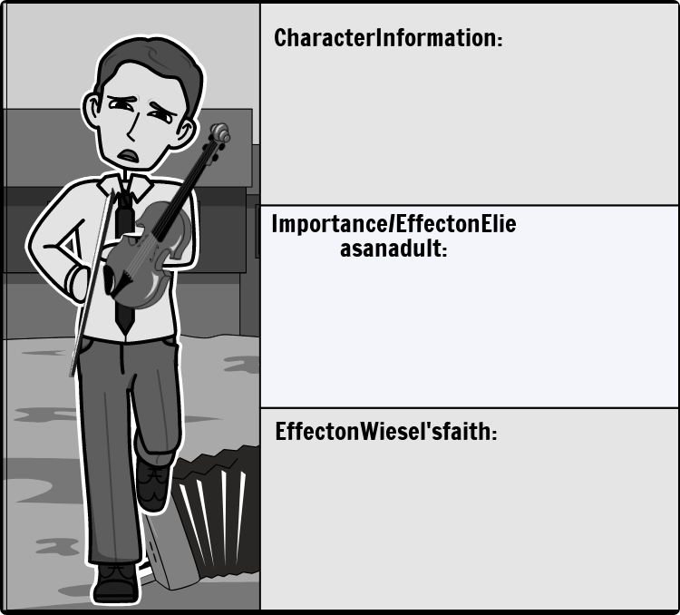
Juliek (Ch. 6)
Directions | Example | Index | Schedule
Insert notes/observations.
Insert notes/observations.
Insert notes/observations.
__________Your Claim___________. “_____Supporting Quote______” (Wiesel _Page Number_).
__________Your Claim___________. “_____Supporting Quote______” (Wiesel _Page Number_).
__________Your Claim___________. “_____Supporting Quote______” (Wiesel _Page Number_).

Slide 7
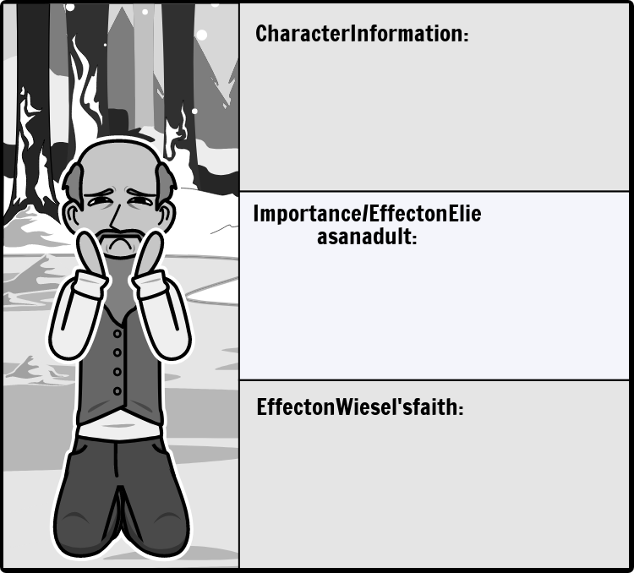
Rabbi Eliahou (Ch. 6-7)
Directions | Example | Index | Schedule
Insert notes/observations.
Insert notes/observations.
Insert notes/observations.
__________Your Claim___________. “_____Supporting Quote______” (Wiesel _Page Number_).
__________Your Claim___________. “_____Supporting Quote______” (Wiesel _Page Number_).
__________Your Claim___________. “_____Supporting Quote______” (Wiesel _Page Number_).

Slide 8
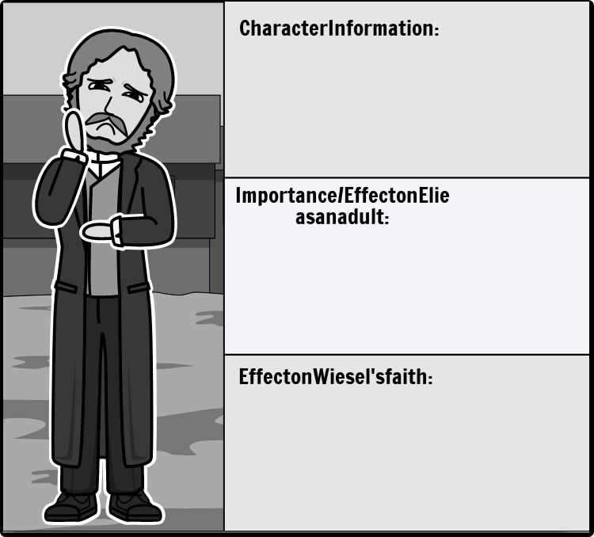
Elie's Father (Shlomo Wiesel) (Ch. 1-7)
Directions | Example | Index | Schedule
Insert notes/observations.
Insert notes/observations.
Insert notes/observations.
__________Your Claim___________. “_____Supporting Quote______” (Wiesel _Page Number_).
__________Your Claim___________. “_____Supporting Quote______” (Wiesel _Page Number_).
__________Your Claim___________. “_____Supporting Quote______” (Wiesel _Page Number_).

Slide 9

Night
Character Map
Graphic Organizer

Slide 10
Directions
For each section (each slide has three sections), write one claim/conclusion, then include one or more supporting quotations from the text accompanied by a citation.
To receive credit on the character map, you must include at least one quotation with a citation. If you forgot to add citations (page numbers), you can easily find the page numbers by searching up your quote in the digital version of the text.

Slide 11
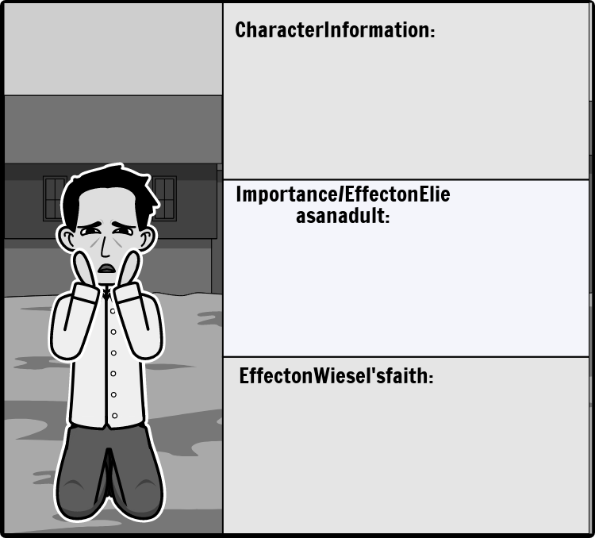
Akiba Drumer

Slide 12
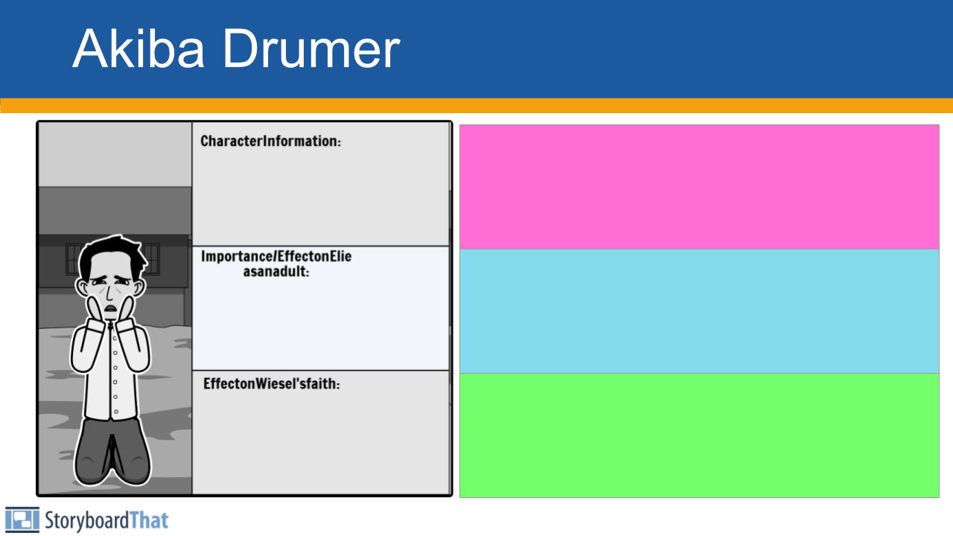
Side Boxes:
These are for observations and connections — not claims.
Character Info / Traits ➤ Who is the character? What do they do? What are they like?
Effect on Elie (as a child or adult) ➤ How does this character affect Elie emotionally, psychologically, or morally?
Effect on Wiesel’s Faith ➤ How does this character’s experience or behavior shape Elie’s beliefs about God?
These don’t need to be “arguments” — they are insights, patterns, or lessons that you notice. You’re just writing down what you see or think is important.

Slide 13
Main Claim + Quote Section:
Do not just drop a quote. Write a complete sentence that makes a point. Then support your point with a quote and citation.
Make a claim about the character — what they do, represent, or show.
Support it with a quote from the text that proves your claim.
Include a citation (Wiesel __).
Make a claim about the character — what they do, represent, or show.
Support it with a quote from the text that proves your claim.
Include a citation (Wiesel __).
Make a claim about the character — what they do, represent, or show.
Support it with a quote from the text that proves your claim.
Include a citation (Wiesel __).

Slide 14
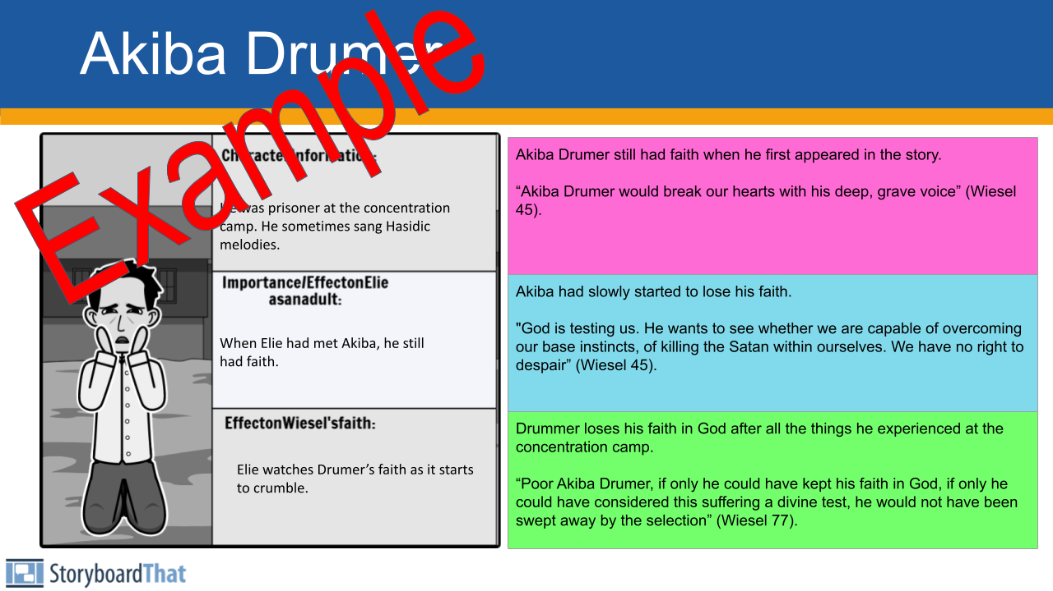

Slide 15
Character Index
1. Moishe the Beadle (p. 3-8)
2. Hilda (p. 4, 8)
3. Bea (p. 4)
4. Tzipora (p. 4, 19)
5. Eliezer
6. Malka (p. 7)
7. Tobie (p. 7)
8. Moishe Chaim Berkowitz (p. 9)
9. Mrs. Kahn (p. 10)
10. Ezra Malik (p. 12)
11. Stern (p. 12, 37)
12. Batia Reich (p. 14)
13. Uncle Mendel (p. 20)
14. Maria (p. 20)
15. Mrs. Schächter (p. 24-28)
16. Béla Katz (p. 35)
17. Yehiel (p. 36)
18. Stein (p. 43-45)
19. Reizel (p. 43-45)
20. Akiba Drumer (p. 45, 51, 76)
21. Hersh Genud (p. 45)
22. Juliek (p. 49, 61-62, 93-95)
23. Louis (p. 49)
24. Hans (p. 49)
25. Franek (p. 49, 55-56)
26. Idek (p. 50, 53, 54, 56-58)
27. Yossi (p. 50, 71-72)
28. Tibi (p. 50, 71-72)
29. Alphonse (p. 51)
30. Zalman (p. 86)
31. Rabbi Eliahu (p. 90-91)
32. Meir Katz (p. 37, 102-103)

Slide 16
Slide Completion Schedule
Eliezer (Elie) Wiesel (Elie’s Faith at the Beginning of The Novel (Chapter 1: pre-Holocaust)): N/A
Moishe the Beadle: 9/12
Idek: TBA
Franek: TBA
Tibi & Yosi: TBA
Eliezer (Elie) Wiesel (Elie’s Faith at the Middle of The Novel): TBA
Juliek: TBA
Eliezer (Elie) Wiesel (Elie’s Faith at the End of The Novel): TBA
Rabbi Eliahou: TBA
Elie's Father (Shlomo Wiesel): TBA
DUE: TBA

